Slide 1
CSE 474 - Group 14
Shamir Roy - 20241015
Tanzim Rahman Sabib - 23141078
ST FARAH
RA AMIT
Page - 01

Slide 2
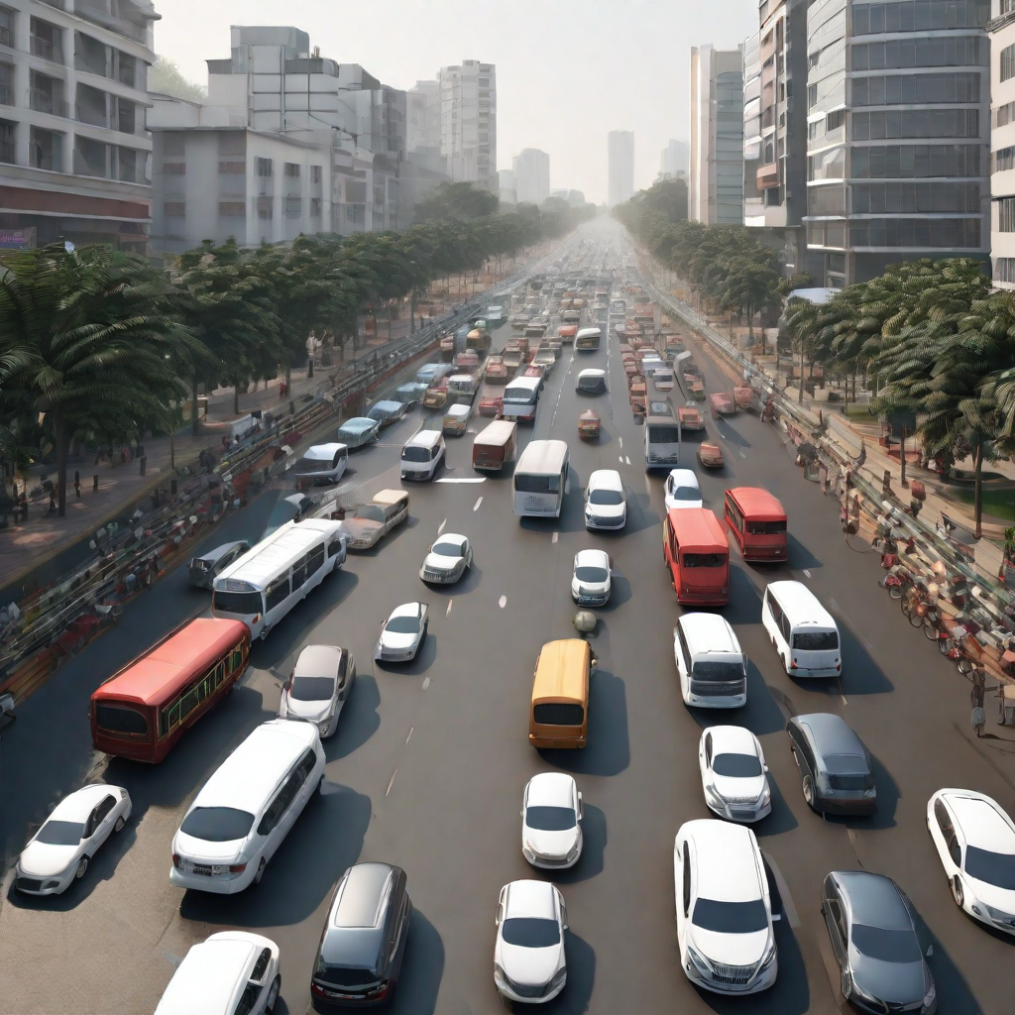
Simulating Traffic Flow in Dhaka City
Page - 02

Slide 3
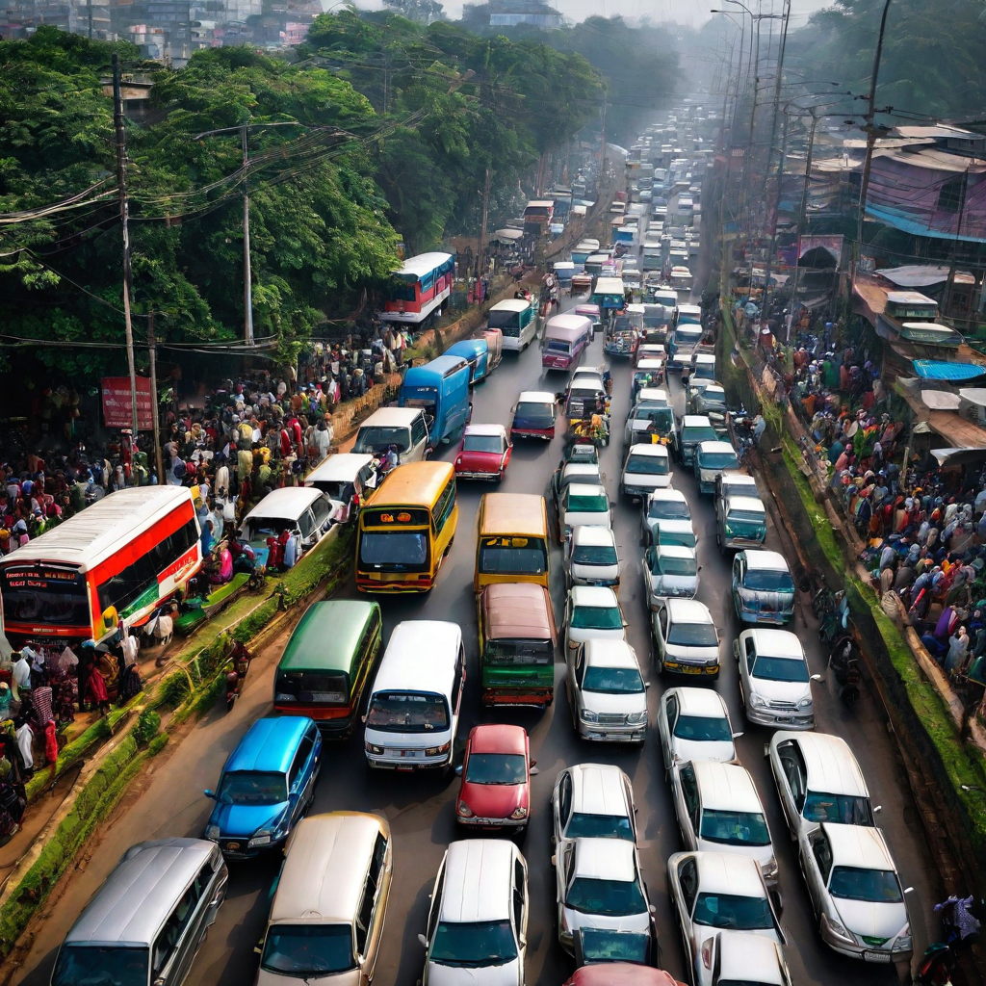
Introduction
Traffic congestion in Dhaka city is a significant issue. It leads to inconvenience, delays, and pollution. To tackle this problem, understanding traffic flow is crucial. Traffic simulation can analyze and model vehicle and pedestrian behavior, aiding in finding effective solutions. By testing different scenarios, we can enhance transportation in Dhaka and reduce congestion.
Page - 03

Slide 4
Why simulate Traffic Flow ?
The main reason behind simulating traffic flow is to generate data without real world. Instead of testing new ideas in real world we can simulate the traffic flow, test our new ideas there without having to interact with the real world. This helps accelerate the optimization and data gather of traffic systems. Simulation is much cheaper and faster alternative to real world testing. The few objectives of simulating traffic flow in Dhaka city are as follows:
To understand the traffic infrastructure in Dhaka city
The understand the causes and effects of traffic jams in Dhaka city
To find some effective solutions to traffic jams
Page - 04

Slide 5
Benefits of traffic simulation
Traffic simulation is an important tool to enable planners to use available budgets and resources as efficiently as possible when expanding or reconstructing transportation systems. Simulation models help to understand the effects that different measures have on traffic volume and traffic flow under different circumstances. So, simulating traffic creates a solid basis for good and cost-effective decisions - making traffic and mobility safe, sustainable, equitable and resilient. In short, it helps to create future-oriented mobility. For example, the effectiveness of a flyover, bridge, tunnels or other systems can be measured using the traffic flow simulation and it helps take the most effective decision as possible and it also reduces unnecessary high costs of traffic projects. Traffic simulation also helps build more safer roads, flyover and other road stuffs.
Page - 05

Slide 6
Our plans & goals
We have certain plans regarding this traffic simulation in Dhaka city such as -
Simulate traffic flow in major areas such as Mohakhali, Bijoy sarani, Banani to see how the number of traffics, speed, intersection affect traffic flow there.
To understand the cause and level of traffic jam.
To understand how to find some effective ways of solving traffic jam issue.
To understand how width of highway can affect traffic flow.
To gain enough knowledge from our simulation which we can use to find the ways of solving traffic jam.
Page - 06

Slide 7
Modeling
Traffic system models are classified into 3 categories such as -
Microscopic models - This represents every vehicle separately.
Macroscopic models - This describes the movement of vehicles as a whole in terms of traffic density and traffic flow.
Mesoscopic models - This is hybrid model that combines the features of both microscopic and macroscopic models. They model flow as “packets” of vehicles.
Page - 07

Slide 8
Literature Review
The passage emphasizes the criticality of traffic flow simulation in Dhaka, addressing the significant issues caused by poor traffic infrastructure. Dhaka's traffic woes result in massive congestion, substantial economic losses, and are detrimental to effective city planning and infrastructure development. The city experiences severe traffic conditions, especially during peak office hours, attributed to diverse vehicle types like buses, private cars, rickshaws, and three-wheelers. Rickshaws on highways notably impact traffic flow.
Regarding traffic flow simulation techniques, microscopic, macroscopic, and mesoscopic models are utilized, yet existing research doesn't specifically address Dhaka's unique traffic complexities. The absence of simulations for a city like Dhaka, especially considering non-compliance with traffic rules, led to a research gap addressed by the work discussed. The simulation demonstrates the potential outcomes of disregarding or partially adhering to traffic regulations, offering a distinct perspective on Dhaka's traffic conditions. Despite limitations in replicating Dhaka's exact environment, the simulation provides insightful albeit not entirely accurate results.
The simulation's significance lies in its utility for comprehending Dhaka's traffic dynamics, aiding in evaluating the impact of potential infrastructure enhancements like bridges, flyovers, and roads. The understanding derived could facilitate the formulation of solutions to alleviate Dhaka's severe traffic congestion, benefiting millions affected by the issue.
Page - 08

Slide 9
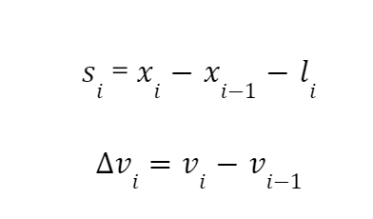
Microscopic model
Here si is the distance between two vehicles and vi is the relative velocity between i-th vehicle and i-1 - th vehicle.
Page - 09

Slide 10
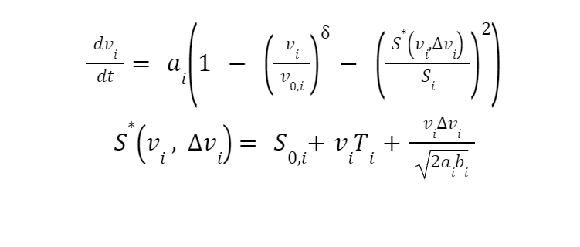
Intelligent Driver Model
The Intelligent Driver Model is a model that Treiber Hennecke invented in 2000. It explains how the i-th vehicle accelerates. The respective equation is as follows:
These parameters are as follows:
s0,i: is the minimum required distance between i-1 th and i-th
vehicle.
v0,i: is the maximum required speed of i-th vehicle
: is the acceleration exponent.
Ti: is the reaction time of i-th vehicle driver.
bi: is the comfortable negative acceleration for the i-th vehicle.
ai: is the highest acceleration allowed for vehicle i
S*: is the actual required distance between (i-1)th vehicle & i-th vehicle.
Page - 10

Slide 11
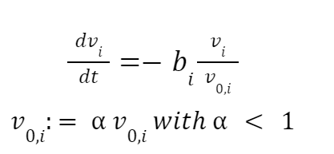
Traffic Road Network Model
We need to simulate a network of connected roads. We require the directed graph G = (V, E) for this.
V represents the set of nodes
The set of edges that stand in for roads is E.
Traffic Light
Traffic lights, which have two distinct zones, such as a stop zone and a slow down zone, are situated at vertices.
Stop Zone: The term "stop zone" refers to the space between stops for moving cars. This can be expressed using the following equation:
Slow down zone: A zone where vehicles slow down is defined by both a slow down factor and a slow down distance. This is made possible by the equation that follows:
Page - 11

Slide 12
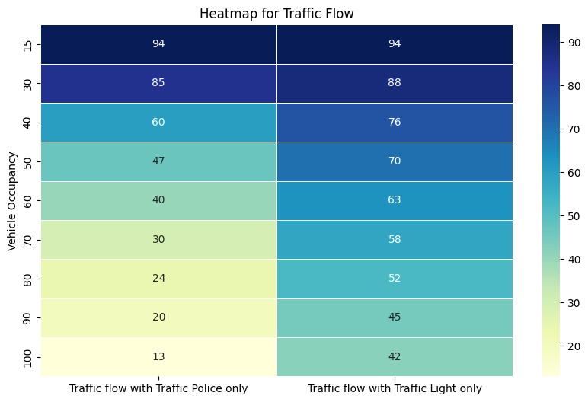
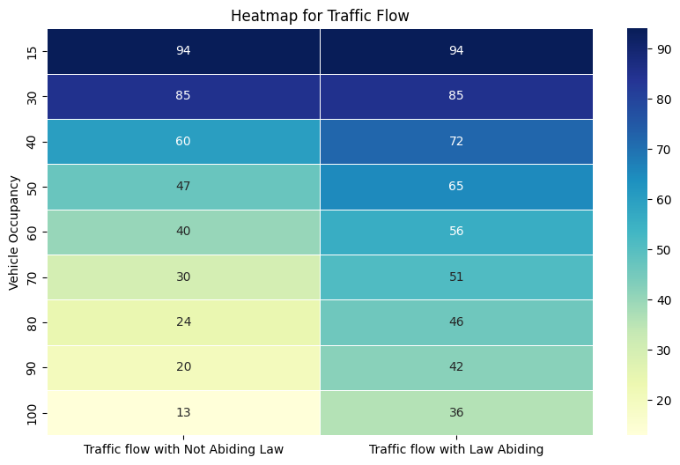
Result Analysis
Page - 12

Slide 13
Result analysis (continued)
After analyzing these simulated data it is visible that the causes of poor traffic flow leading to traffic jams are massive numbers of vehicles in peak hours with not enough roads, highways, poor law obedience by the pedestrians and drivers. It is also visible that traffic light controlled traffic systems are more efficient than traffic police controlled traffic systems resulting in better traffic flow when traffic light controlled traffic systems are used. So some of the solutions of poor traffic flow leading to traffic jams in Dhaka city are as follows:
Increasing number of roads, highways, making well spacious highways, roads with more lanes.
Traffic law should be strictly followed by both drivers and pedestrians.
Traffic light controlled traffic systems should be introduced to all traffic zones in Dhaka.
Page - 13

Slide 14
Thank you

